Slide 1
Text analytics
INFO-7390 Advances Data science/Architecture
Team 11

Slide 2
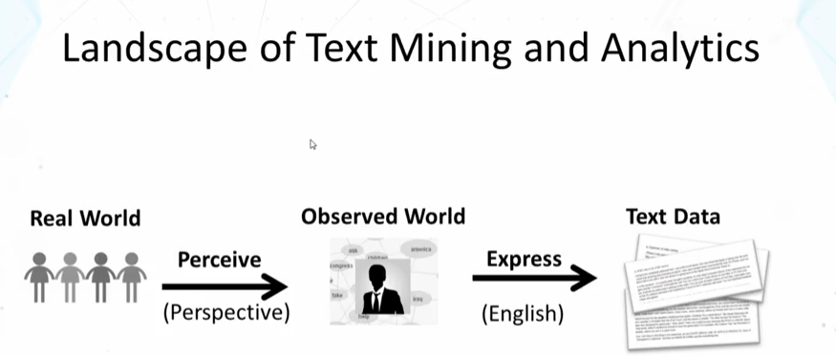
What is text analytics ?
Text mining ~ Text analytics
Turn text data into high quality information or actionable knowledge

Slide 3
Subtasks in text analytics
Information retrieval or identification of a corpus is a preparatory step: collecting or identifying a set of textual materials, on the Web or held in a file system, database, or content corpus manager, for analysis.
Apply advanced statistical methods: apply more extensive natural language processing, such as part of speech tagging, syntactic parsing, and other types of linguistic analysis.
Named entity recognition: uses statistical techniques to identify named text features: people, organizations, place names, stock ticker symbols, certain abbreviations, and so on
Recognition of Pattern Identified Entities: Features such as telephone numbers, e-mail addresses, quantities (with units) can be discerned via regular expression or other pattern matches.

Slide 4
Subtasks in text analytics (contd..)
Coreference: identification of noun phrases and other terms that refer to the same object.
Relationship, fact, and event Extraction: identification of associations among entities and other information in text
Sentiment analysis involves discerning subjective (as opposed to factual) material and extracting various forms of attitudinal information: sentiment, opinion, mood, and emotion.
Quantitative text analysis is a set of techniques stemming from the social sciences where either a human judge or a computer extracts semantic or grammatical relationships between words in order to find out the meaning or stylistic patterns of, usually, a casual personal text for the purpose of psychological profiling etc.

Slide 5
NLP(Natural Language Processing)
What is natural language?
Refers to language spoken by people e.g. English, Japanese, Chinese etc., as opposed to artificial languages like C++, JAVA, etc.
Definition of NLP:
A field of computer science, artificial intelligence, and computational linguistics concerned with the interactions between computers and human (natural) languages and, in particular, concerned with programming computers to fruitfully process large natural language corpora

Slide 6
Why NLP?
Huge amount of data
Internet = more than 20 billion pages
  Text data – websites, blogs, tweets
  Audio data – speech
  Applications for processing large amounts of texts requires NLP expertise

Slide 7
Steps in NLP
Morphological analysis
  Individual words are analysed into their component and non-word tokens
  Punctuations are separated from word
  E.g. Carried = carry + ed
Syntactic Analysis
  Grammatical structure of a sentence is analysed
  Some word sequence may be rejected if they violate the rules of language
  E.g. Boy the go the to store ( Syntactic analyser rejects it)

Slide 8
Steps in NLP (contd..)
Semantic analysis
  Determine possible meaning of sentence
  Sentence which has no meaning is rejected
  E.g. “Colourless green ideas” has no meaning
Discourse Analysis
  The meaning of an individual sentence may depends on the sentence that precede it and may influence the meaning of sentences that follow it
  E.g. John wanted it (the word it depends on John)

Slide 9
Steps in NLP
Pragmatic analysis
  It derives knowledge from external common sense information
  It meant understanding purposeful use of language in a situation
  E.g.“Do you know what time it is?”
  Should be interpreted as request

Slide 10
Major areas of NLP
Speech processing
  Text to speech
  Converting electronic text to digital speech
  Automatic speech recognition
    Automatic transcription of spoken content to electronic text
    Speech to Speech translation
    Translating spoken content from one language to another in real time or offline

Slide 11
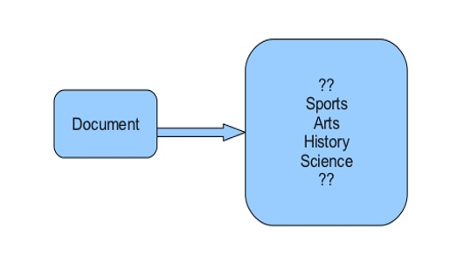
Document Classification
Practical usage include
Deciding whether an email is spam or not.
Deciding what the topic of a news article is, from a fixed list of topic areas such as "sports," "technology," and "politics."
Deciding whether a given occurrence of the word bank is used to refer to a river bank, a financial institution, the act of tilting to the side, or the act of depositing something in a financial institution

Slide 12
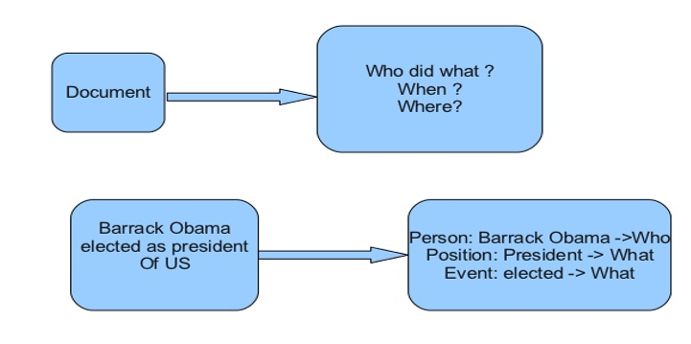
Information Extraction
Recovering structured data from formatted text
  Identifying fields (e.g. named entity recognition)
  Understanding relations between fields (e.g. record association)
  Normalization and deduplication

Slide 13
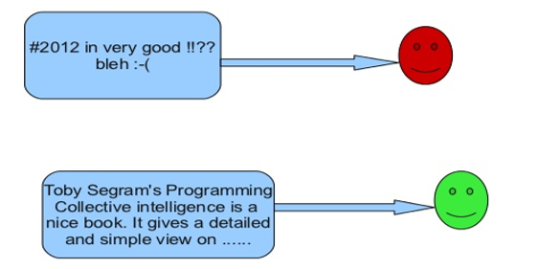
Sentiment Analysis

Slide 14
NLTK(Natural Language Toolkit)
A leading platform for building Python programs to work with human language data.
It provides easy-to-use interfaces to over 50 corpora and lexical resources such as WordNet, along with a suite of text processing libraries for classification, tokenization, stemming, tagging, parsing, and semantic reasoning.

Slide 15
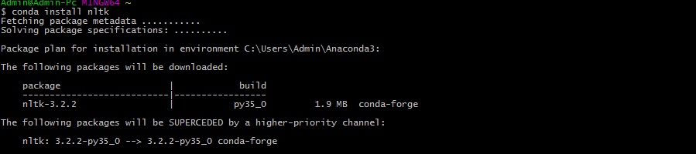
How to install NLTK?
1. $ conda install nltk
2. In ipython shell,
[1] : import nltk
[2] : nltk.download()
This will open a new window

Slide 16
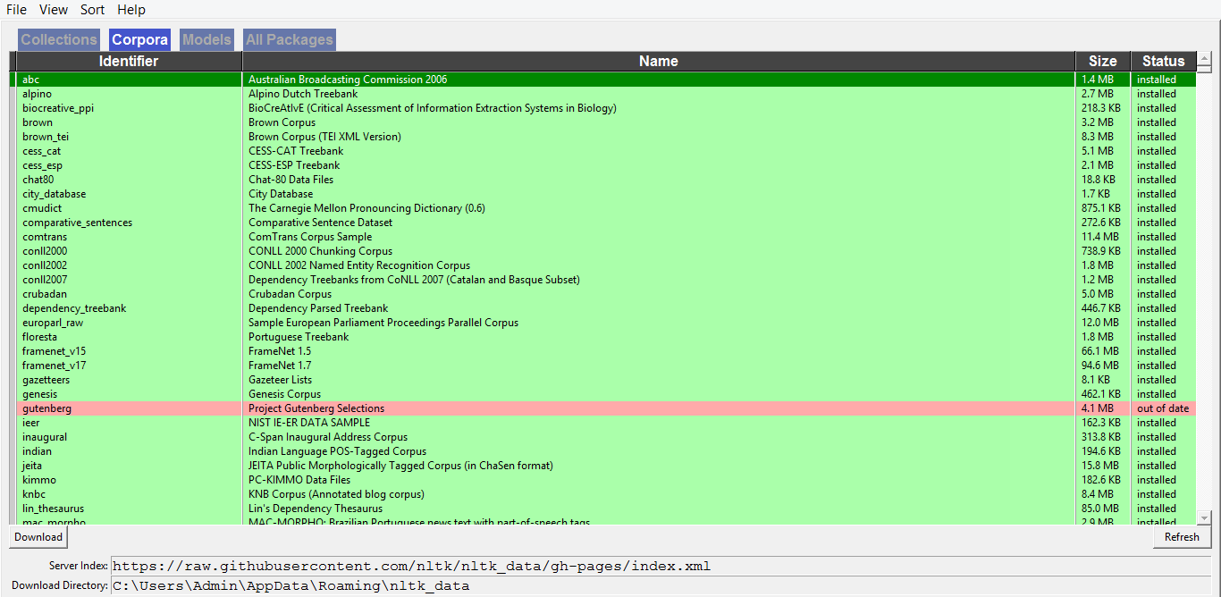

Slide 17
Demo

Slide 18
Twitter Text Analysis
Part 1: Collecting Data
Register Your App
In order to have access to Twitter data programmatically, we need to create an app that interacts with the Twitter API.
The first step is the registration of your app. In particular, you need to point your browser to http://apps.twitter.com, log-in to Twitter (if you’re not already logged in) and register a new application.

Slide 19
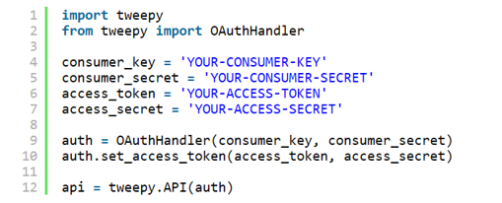
Accessing the data
pip install tweepy==3.3.0

Slide 20
Reading timeline(Twitter homepage)
Collecting Tweets
for status in tweepy.Cursor(api.home_timeline).items(10):
# Process a single status
print(status.text)
Processing and storing the JSON
for status in tweepy.Cursor(api.home_timeline).items(10):
# Process a single status
process_or_store(status._json)

Slide 21
What if we want to have list of followers?
List of all our followers
for friend in tweepy.Cursor(api.friends).items():
process_or_store(friend._json)
List of all Tweets
for tweet in tweepy.Cursor(api.user_timeline).items():
process_or_store(tweet._json)
Storing Tweets
def process_or_store(tweet):
print(json.dumps(tweet))

Slide 22


Semantic Orientation
Difference between its associations with positive and negative words. In practice, we want to calculate “how close” a word is with terms like good and bad
Given the set of documents (tweets) D, we define the Document Frequency (DF) of a term as the number of documents where the term occurs.

Slide 23
Computing Semantic Orientation
pmi = defaultdict(lambda : defaultdict(int))
for t1 in p_t:
for t2 in com[t1]:
denom = p_t[t1] * p_t[t2]
pmi[t1][t2] = math.log2(p_t_com[t1][t2] / denom)
semantic_orientation = {}
for term, n in p_t.items():
positive_assoc = sum(pmi[term][tx] for tx in positive_vocab)
negative_assoc = sum(pmi[term][tx] for tx in negative_vocab)
semantic_orientation[term] = positive_assoc - negative_assoc

Slide 24
The Semantic Orientation of a term will have a positive (negative) value if the term is often associated with terms in the positive (negative) vocabulary
The value will be zero for neutral terms

Slide 25
Word2Vec
Word2vec is a two-layer neural net that processes text.
Its input is a text corpus and its output is a set of vectors: feature vectors for words in that corpus.(a collection of written texts, especially the entire works of a particular author or a body of writing on a particular subject)
It turns text into a numerical form that deep nets can understand
Its applications extend to genes, code, likes, playlists, social media graphs and other verbal or symbolic series in which patterns may be discerned.

Slide 26
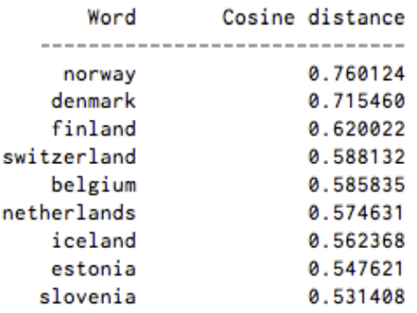
Word2Vec
The output of the Word2vec neural net is a vocabulary in which each item has a vector attached to it, which can be fed into a deep-learning net or simply queried to detect relationships between words
Measuring cosine similarity, no similarity is expressed as a 90 degree angle, while total similarity of 1 is a 0 degree angle, complete overlap;
list of words associated with “Sweden” using Word2vec

Slide 27
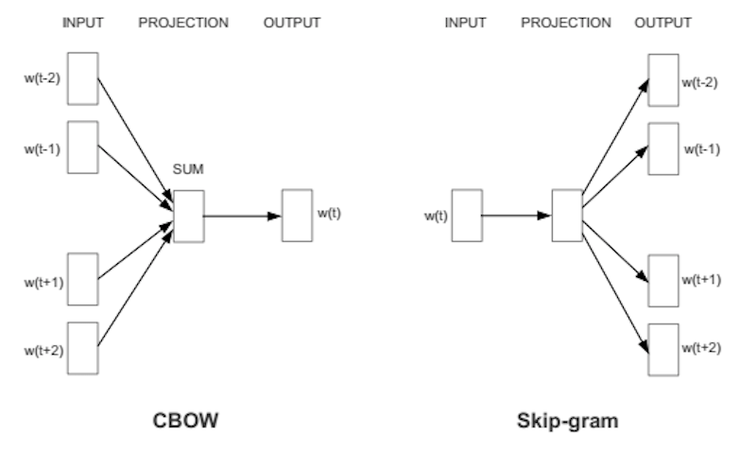
Word2Vector Prediction
Two Ways of word2vector prediction:
CBOW or continuous bag of words, (using context to predict a target word )
Skip-gram using a word to predict a target context

Slide 28
Neural Word Embeddings
Neural word embedding represents a word with numbers
natural language processing systems traditionally treat words as discrete atomic symbols, and therefore 'cat' may be represented as Id537 and 'dog' as Id143
http://localhost:8889/notebooks/word2vec.ipynb

Slide 29
AlchemyAPI service on IBM Bluemix
Two APIs from AlchemyAPI:
The Concept Tagging API provides a ranked list of relevant concepts in the document. This API uses rich-text analysis to identify concepts that aren't explicitly referenced. It also provides links so that users can quickly locate relevant data.
The Taxonomy API provides a nested categorization of concepts in the document. Users can quickly scan and focus in on their chosen topic.

Slide 30
Taxonomy API
https://www.ibm.com/developerworks/library/cc-analyze-notes-alchemyapi-trs-bluemix/

